Slide 1
SIMULATING THE asteroid belt WITH TREE CODES
Steven Shockley

Slide 2
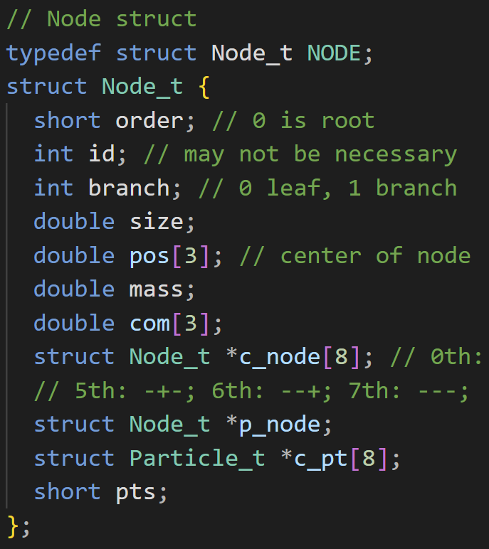
The Code: Barnes-Hut
Custom datatypes (structs): NODE, PARTICLE (and POLAR)
Initializing functions (e.g. create_node())
Worker functions (build_tree(), add_force())
Crucial parameter: θ_{crit}, default 0.05

Slide 3
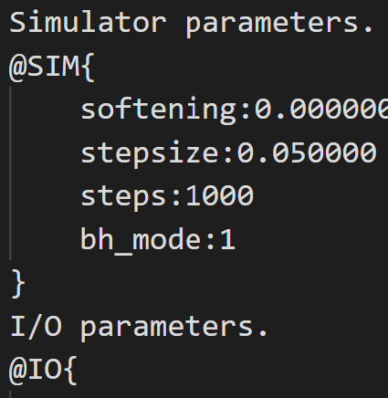
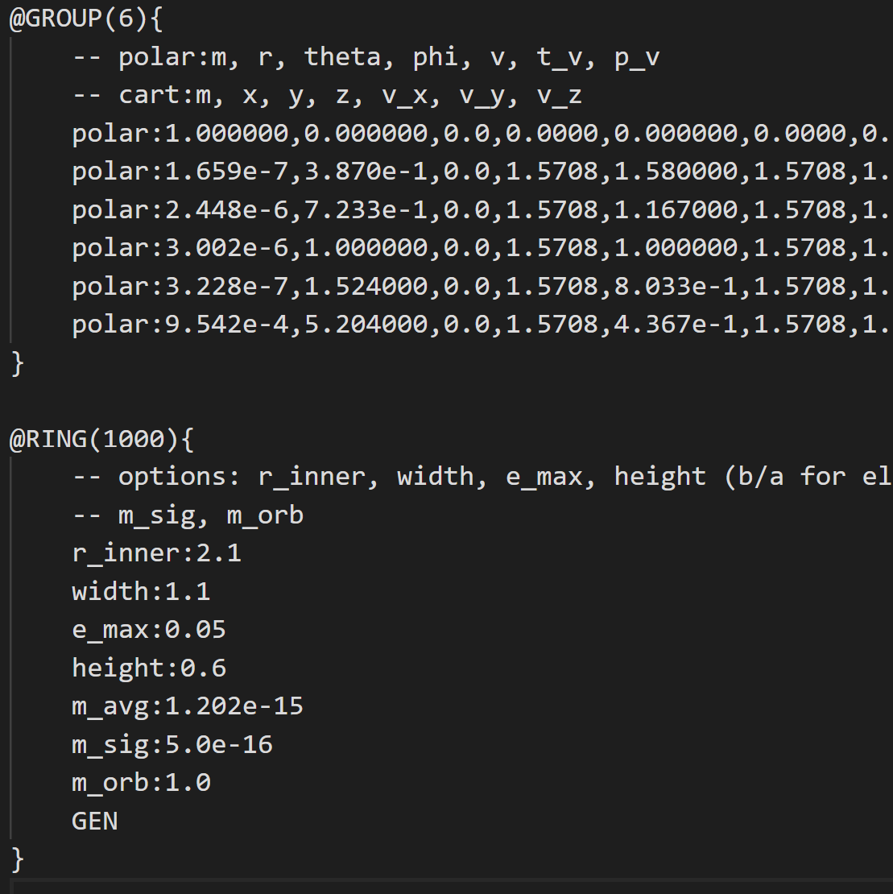
The Code: Scripting
Flexible object creation using scripts
Implemented objects include GROUP and RING, used for these simulations
Most options handled in pre-processed scripts
Includes softening, steps, stepsize, files…

Slide 4
The results

Slide 5
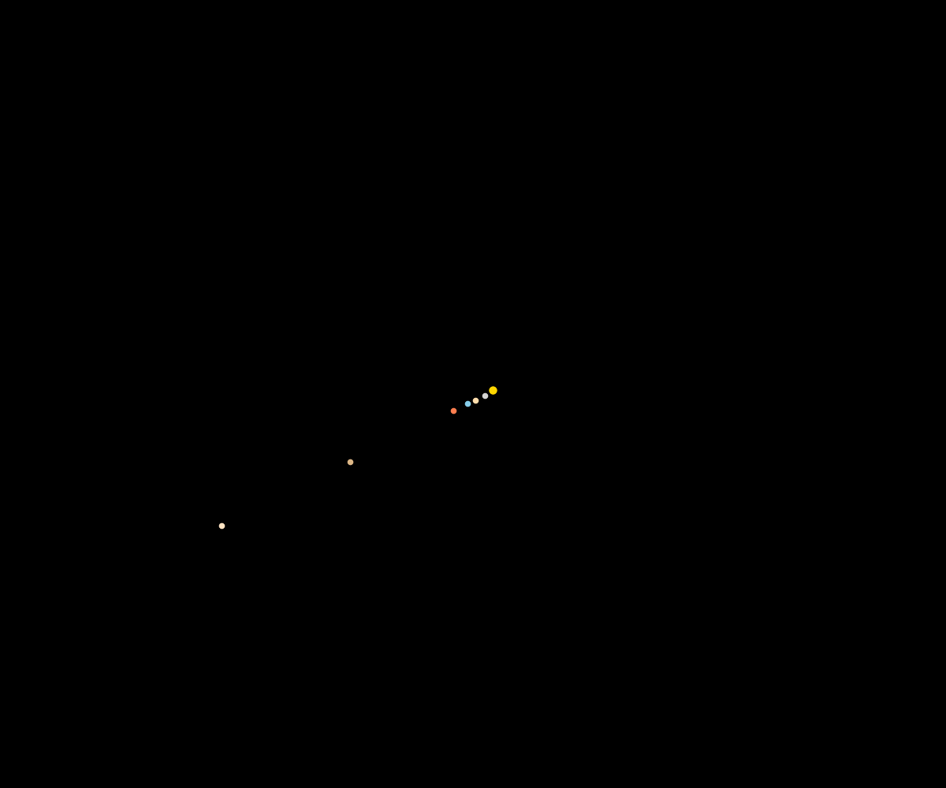

Slide 6
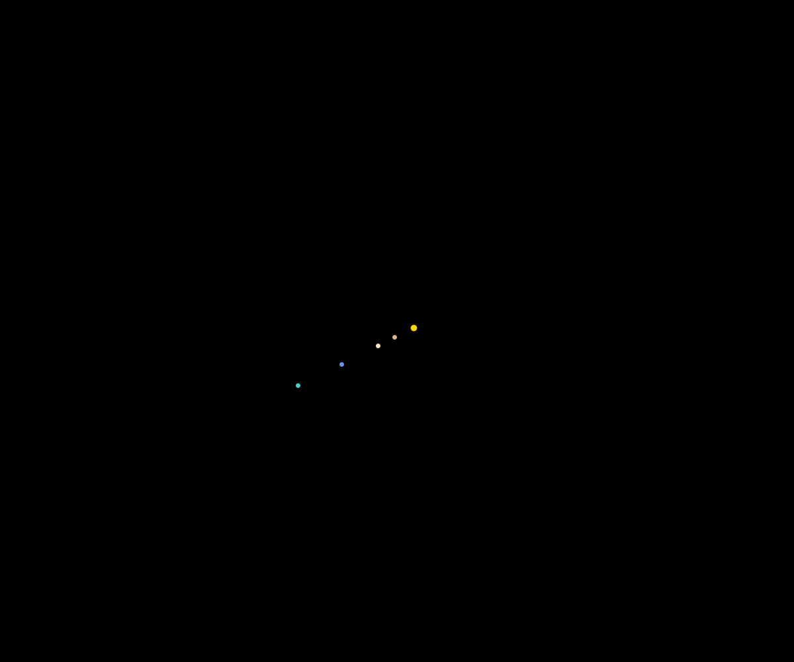

Slide 7
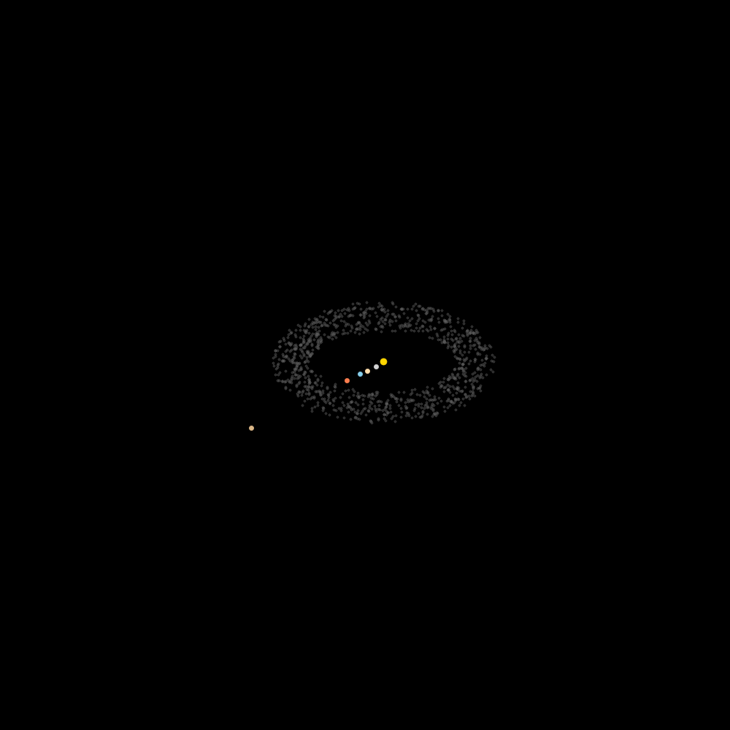
INNER PLANETS WITH ASTEROID BELT

Slide 8
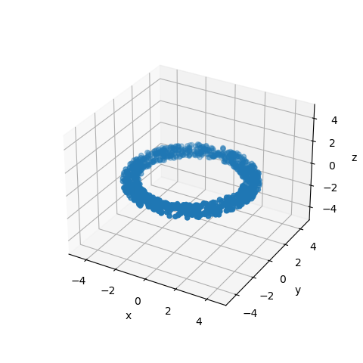
Assumptions
Asteroid belt is a torus
Minor radius of 2.1 AU, major of 2.65 AU
Cross-sectional ellipse where b/a = 0.2
Low amount of particles, realistic point mass
~1x10¹⁵ kg per particle
1,000 particles
~1,000,000 lighter than real asteroid belt

Slide 9
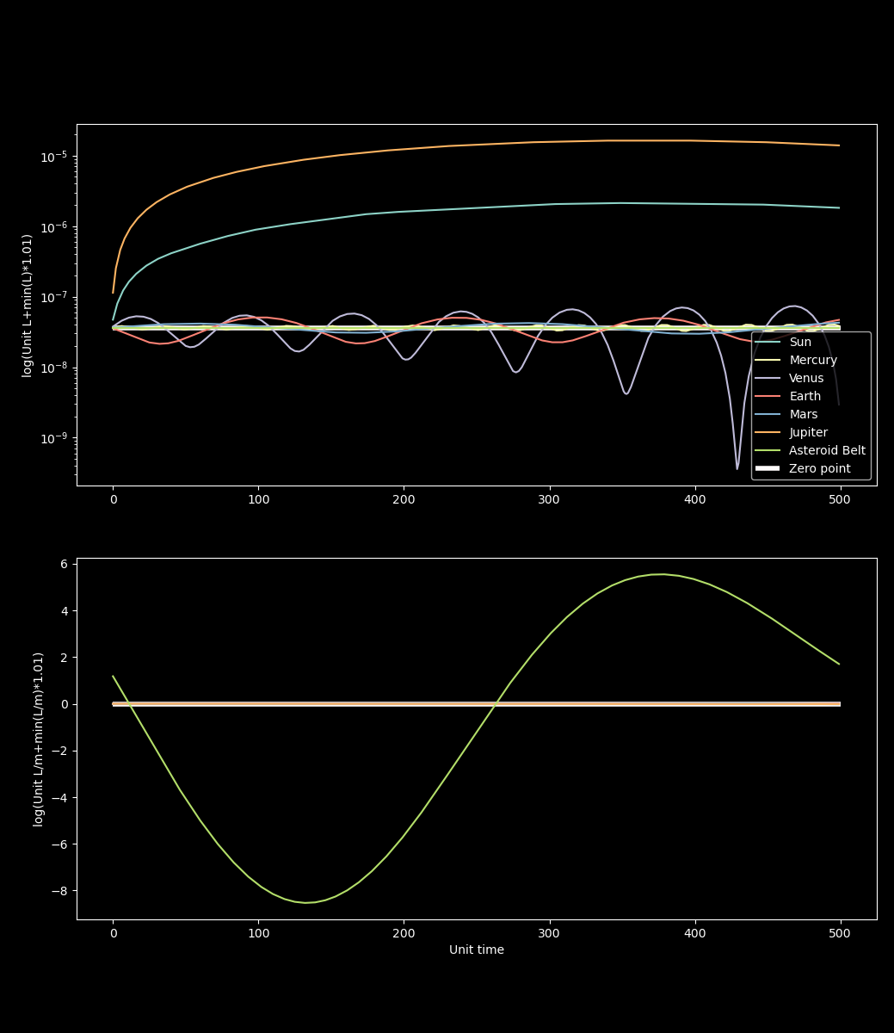
Angular Momentum
L is dominated by Jupiter and the Sun
All objects oscillate in L
Specific angular momentum dominated by asteroid belt

Slide 10
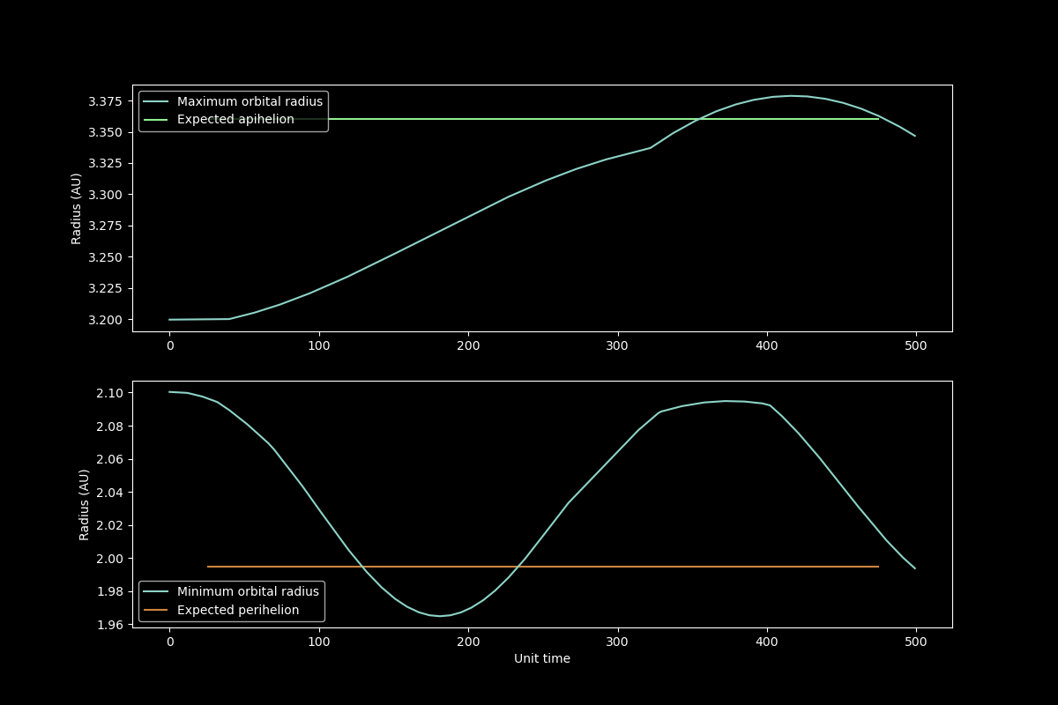

Slide 11
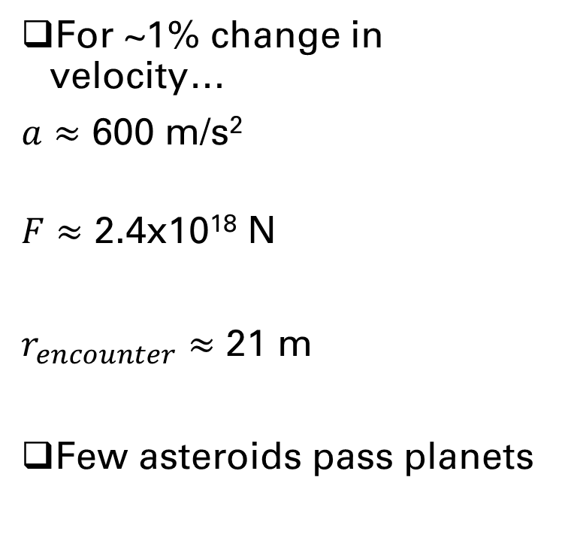
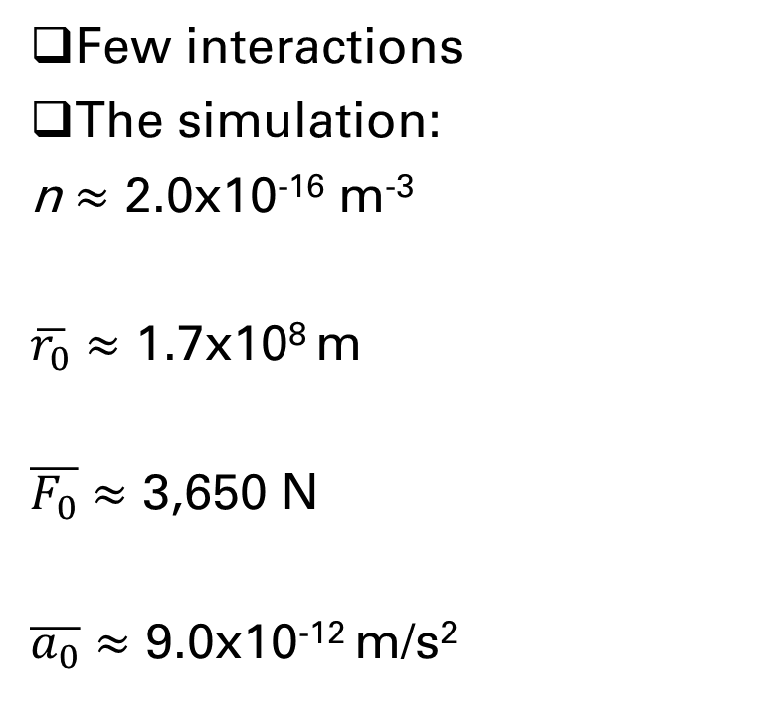
Limitations
Few interactions
The simulation:
n $≈$ 2.0x10⁻¹⁶ m⁻³
$\overline{r_{0}}≈$ 1.7x10⁸ m
$\overline{F_{0}}≈$ 3,650 N
$\overline{a_{0}}≈$ 9.0x10⁻¹² m/s²
For ~1% change in velocity…
$a≈$ 600 m/s²
$F≈$ 2.4x10¹⁸ N
$r_{encounter}≈$ 21 m
Few asteroids pass planets

Slide 12
Increase the mass or density

Slide 13
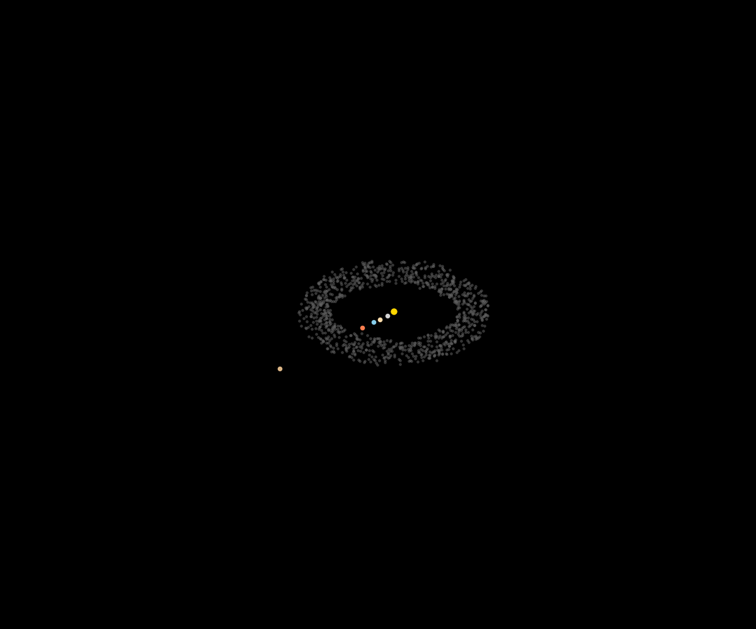
HIGH MASS ASTEROID BELT

Slide 14
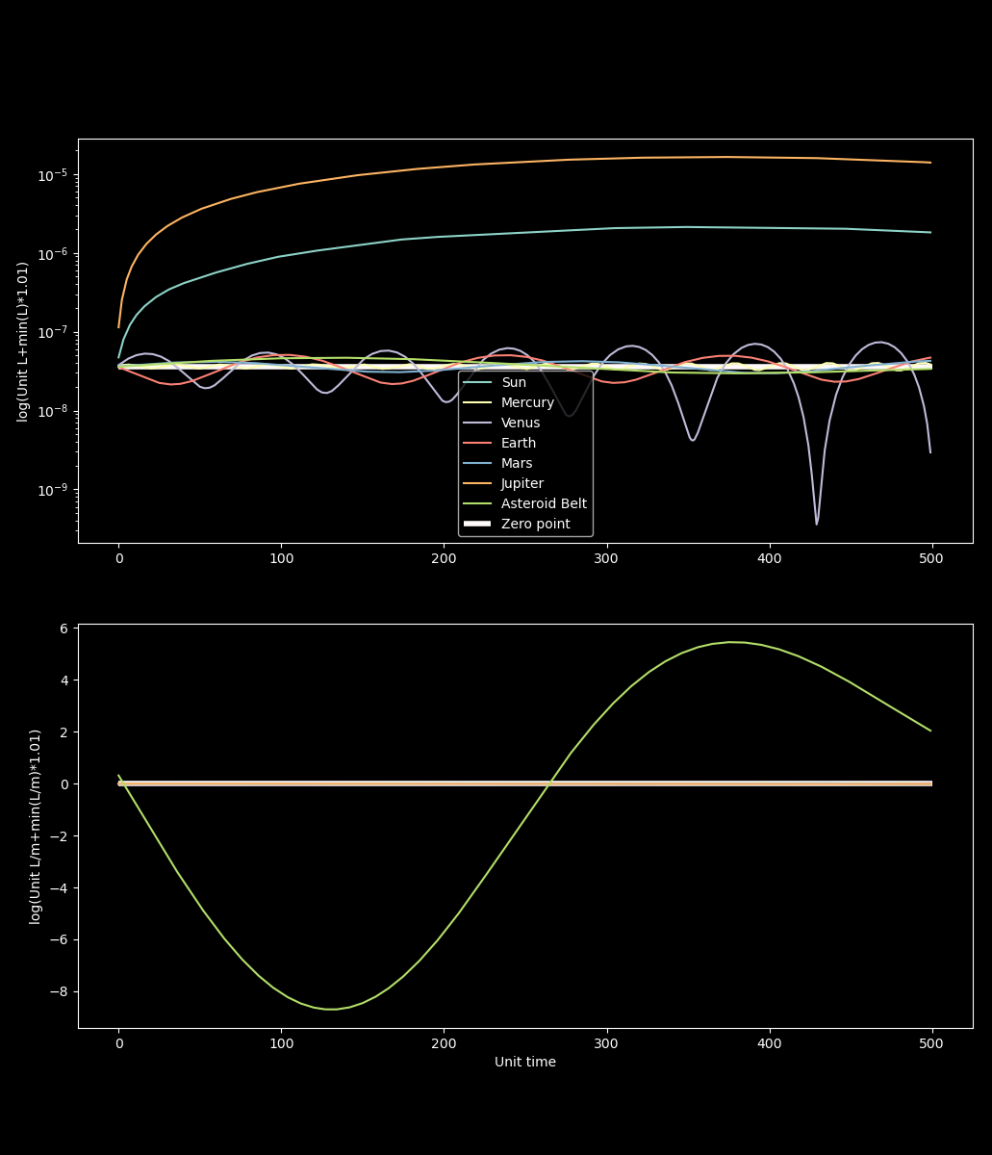
High Mass Case
Plots similar to previous case, with different magnitudes
Little to no changes in results
Either density must be increased, or initial velocities and distribution result in little interaction

Slide 15
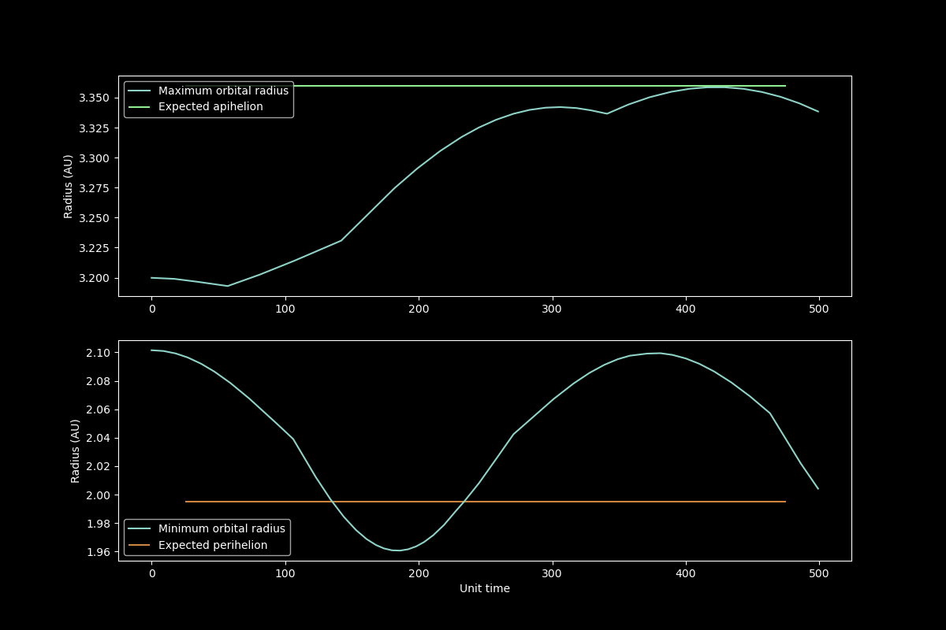

Slide 16
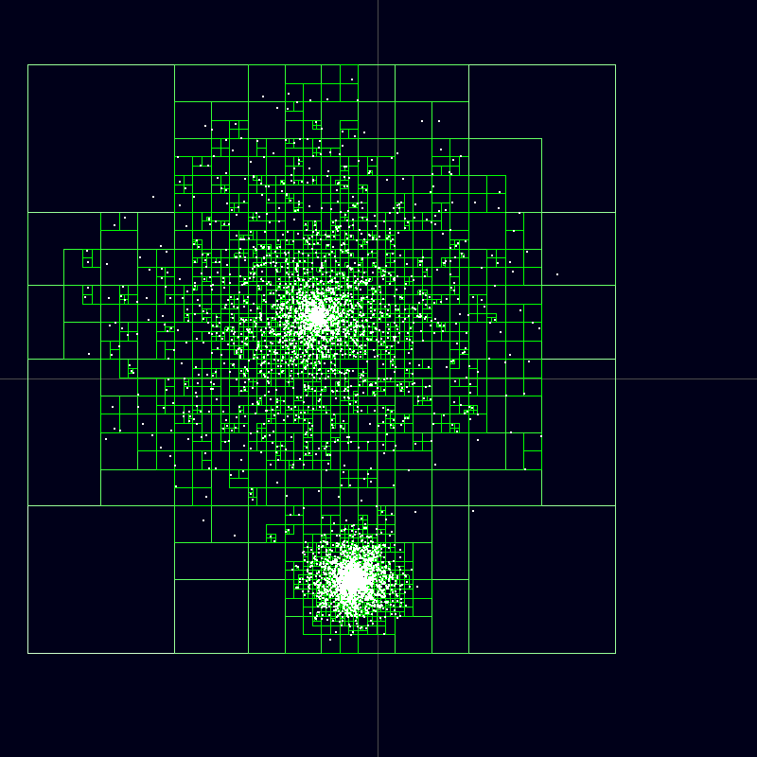
Approaching High Density
Increasing number density almost prohibitively slow
But with B-H, can loosen θ_{crit}
Can simulate 10,000 particles in comparable time
Though plotting becomes prohibitively slow…

Slide 17
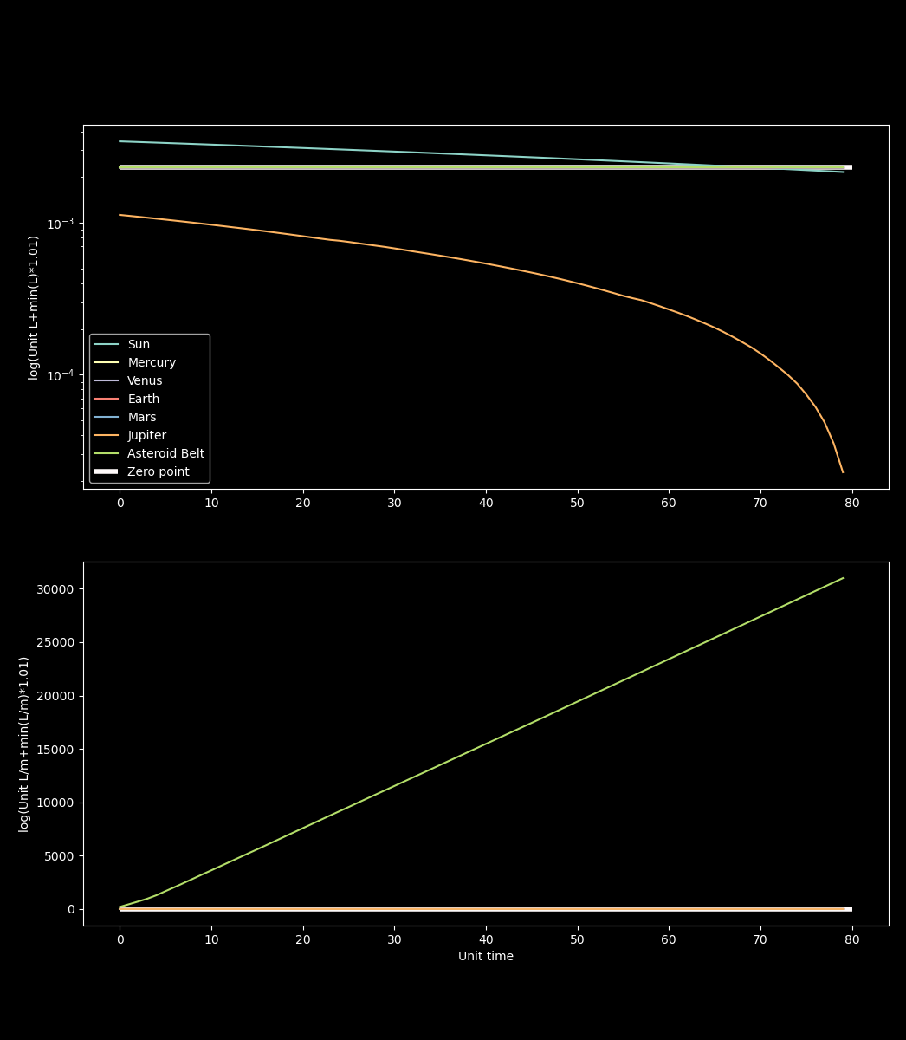
High Density Case
Angular momentum plots look… off
No oscillation, Jupiter’s L decreases unconstrained
Asteroid belt’s specific angular momentum increases unconstrained
It can’t be that bad, right?

Slide 18
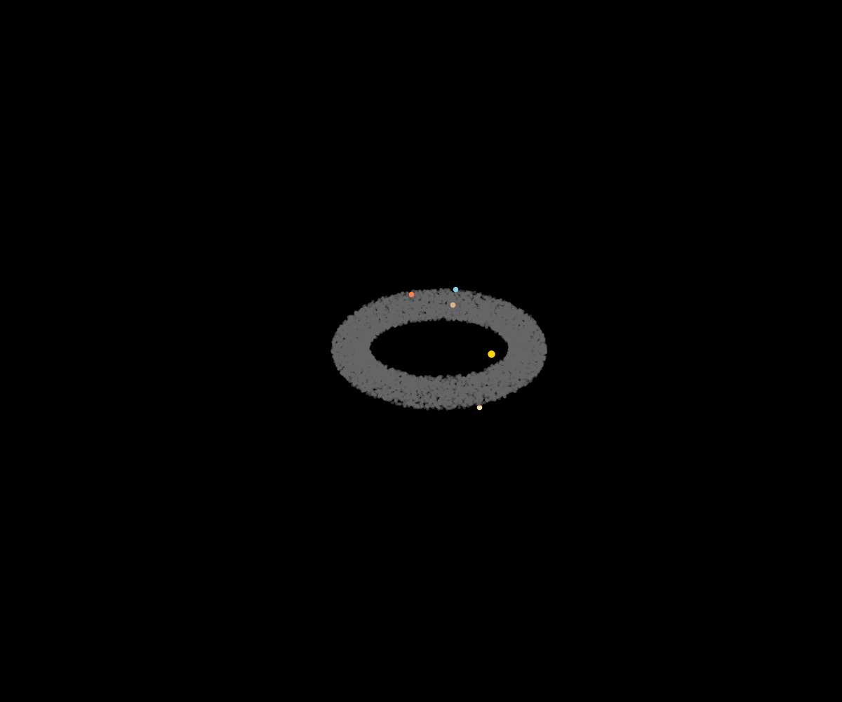
HIGH DENSITY ASTEROID BELT

Slide 19
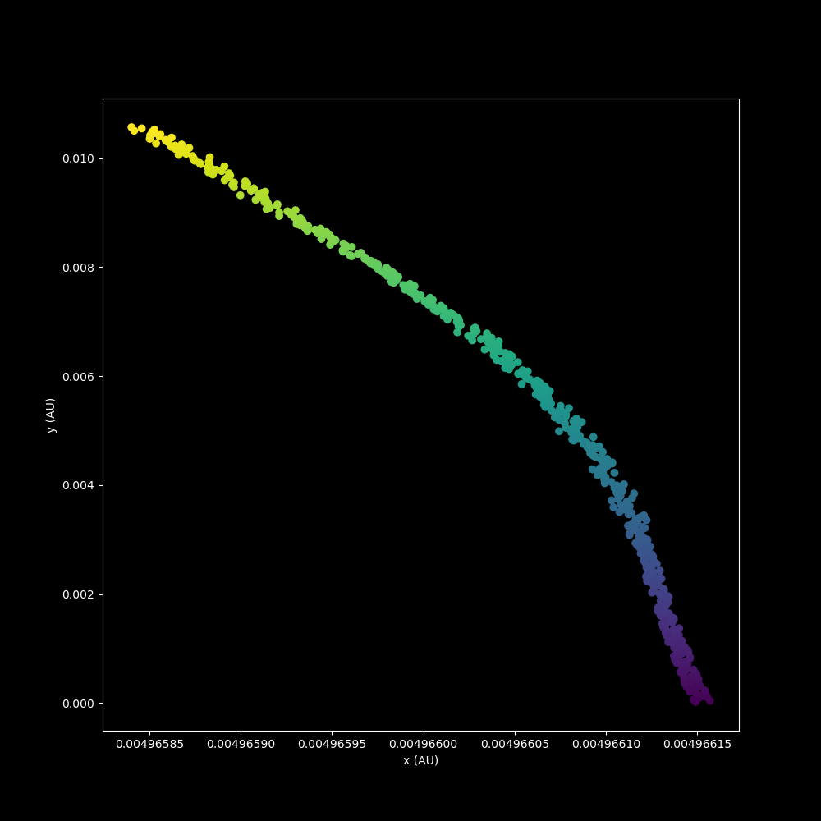
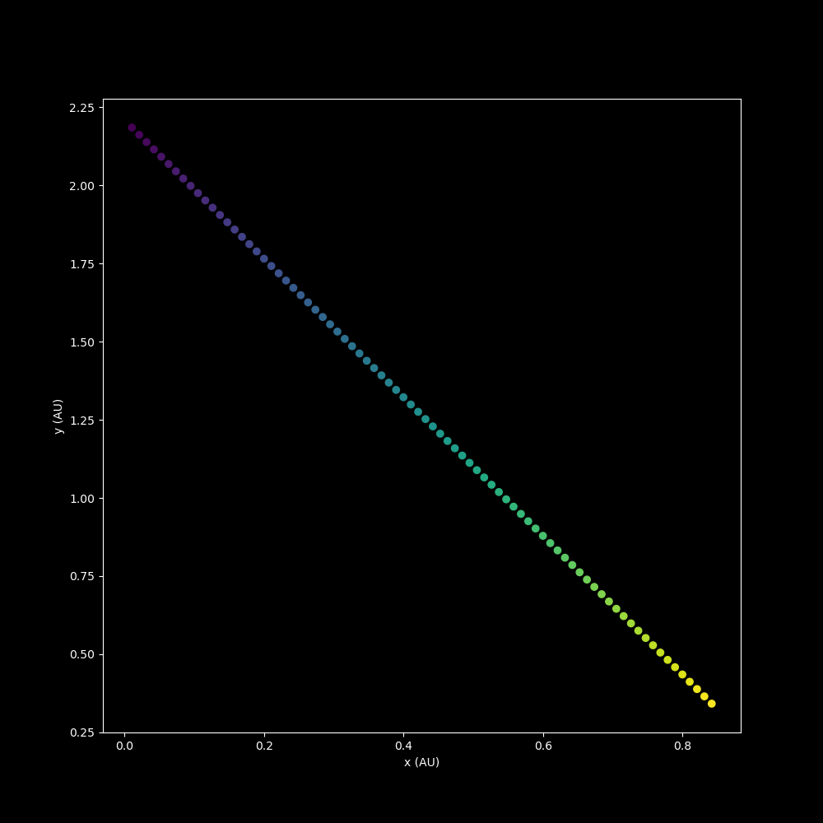
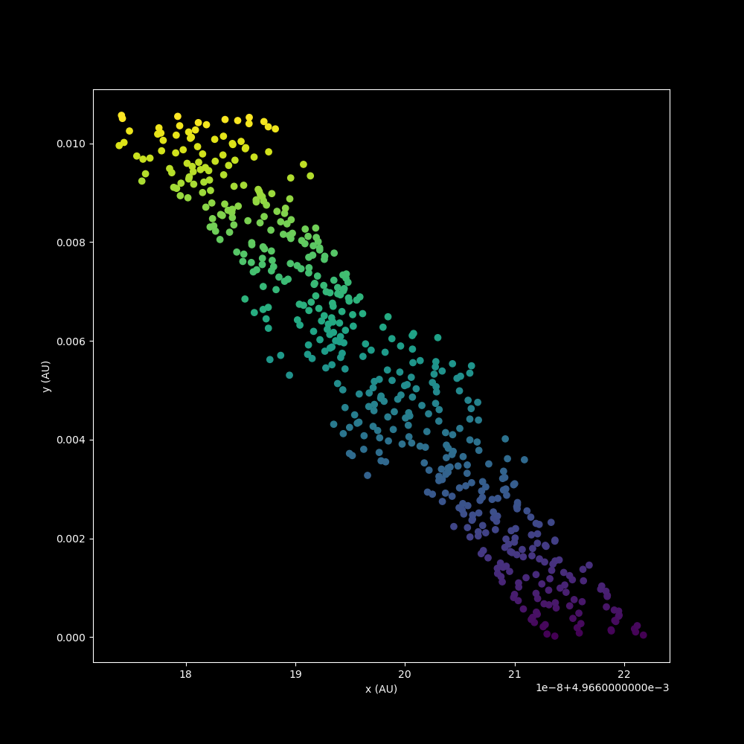
Center of Mass Evolution
Most scatter in original case – darker points are earlier in simulation
Bend to the curve in high mass, but more constrained
Straight line and opposite direction in high density

Slide 20
A DIFFERENT PROBLEM… CAN JUPITER CLEAR ITS ORBIT?

Slide 21
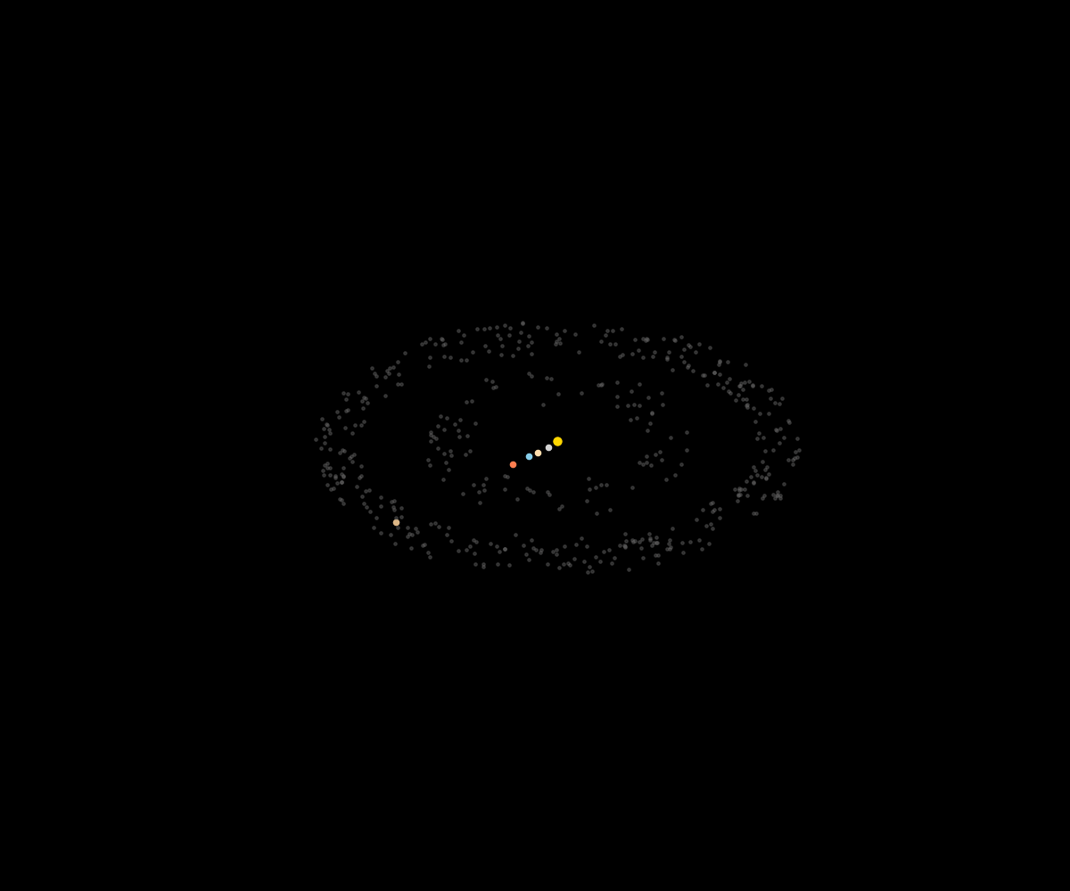
ADDITIONAL RING AROUND JUPITER

Slide 22
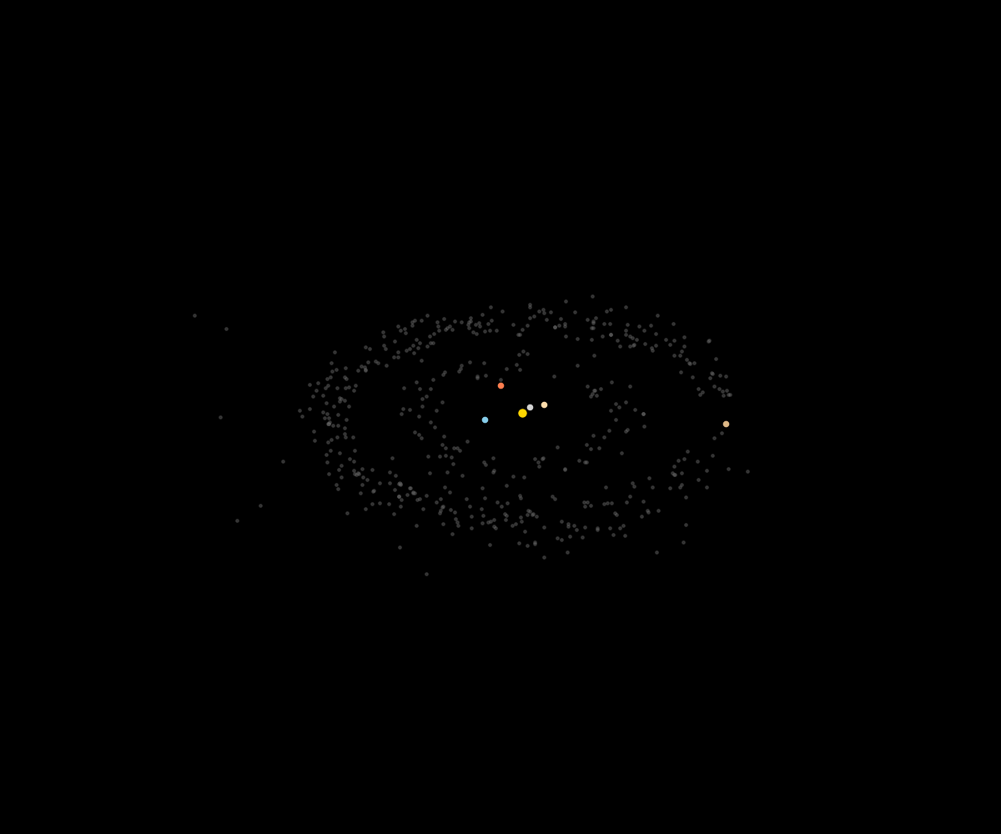
AFTER 4,000 YEARS

Slide 23
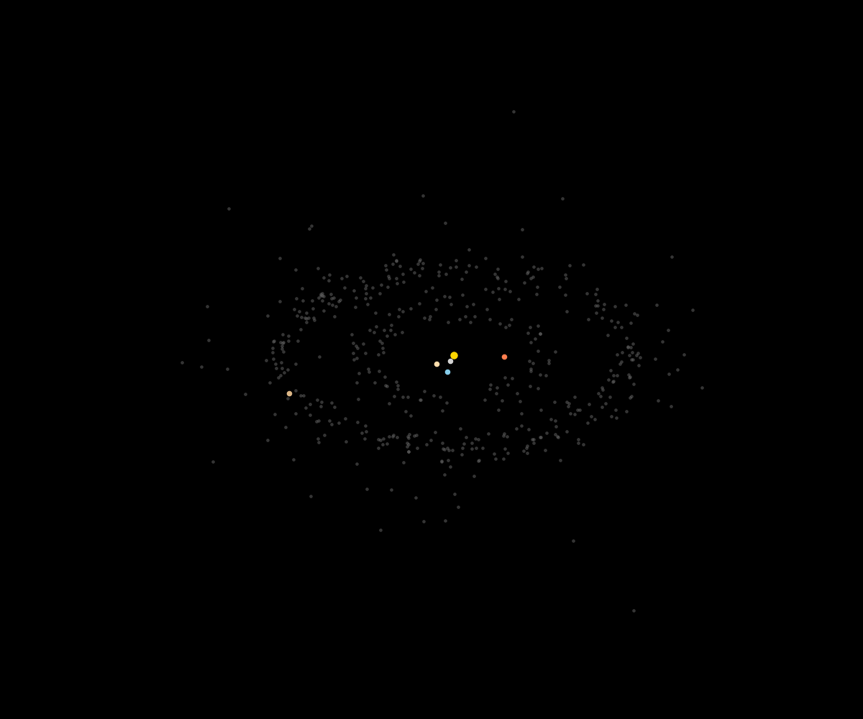
AFTER ANOTHER 40,000 YEARS

Slide 24
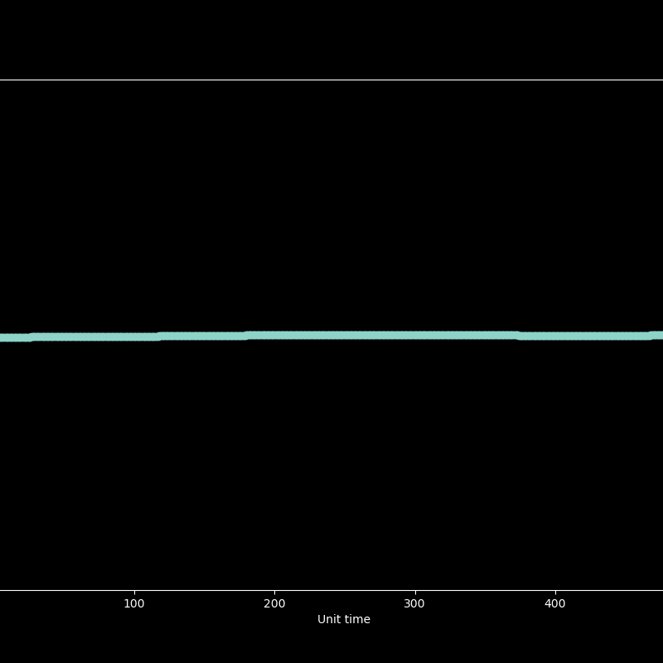
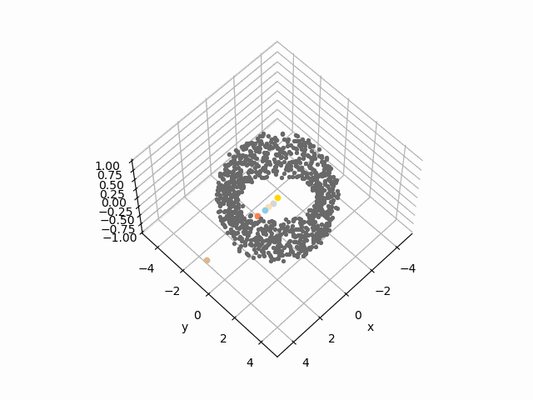
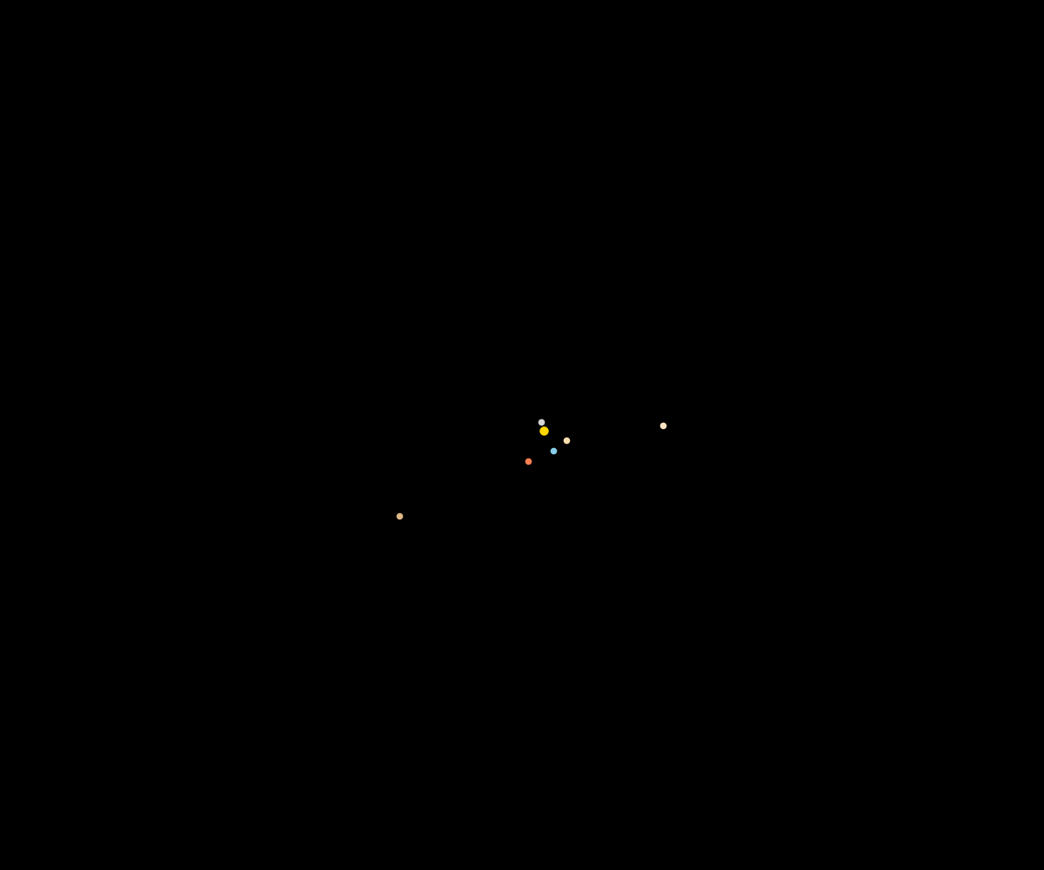
Thank you

